Slide 1
Cross-Validation

Slide 2
Cross-validation is a method used to test how well a machine learning model works on new data and to reduce overfitting. It works by:
Dividing the dataset into multiple parts (folds).
Training the model on some parts and testing it on the remaining part.
Repeating the process by changing the test part each time.
Calculating the average result from all tests to get the final model performance.
Types of Cross-Validation
There are different types of cross-validation methods used to evaluate machine learning models.
1. Holdout Validation In the Holdout Validation method, the dataset is divided into two parts. Usually, 50% of the data is used for training and 50% for testing. This method is simple and fast to implement. However, the main disadvantage is that only half of the data is used for training, so the model may miss important patterns present in the remaining data, which can lead to high bias.

Slide 3
2. LOOCV (Leave-One-Out Cross Validation) In this method, the model is trained on the entire dataset except one data point, which is used for testing. This process is repeated for every data point in the dataset.
Almost all data is used for training, so bias is low.
Testing on only one data point can lead to high variance, especially if the point is an outlier.
(High variance means the model is too complex and fits the training data too closely, causing poor performance on new data.)
It is computationally expensive for large datasets because the model must be trained once for every data point.
3. Stratified Cross-Validation Stratified cross-validation ensures that each fold has the same class distribution as the original dataset. It is mainly used when the dataset is imbalanced (some classes have very few samples).
The dataset is divided into k folds while keeping the class proportion the same in each fold.
In every iteration, one fold is used for testing and the remaining folds are used for training.
The process is repeated k times, so each fold becomes the test set once.
This helps classification models perform better by maintaining balanced class distribution.

Slide 4
4. K-Fold Cross Validation
K-Fold Cross Validation divides the dataset into k equal parts (folds). The model is trained on k-1 folds and tested on the remaining fold. This process is repeated k times, and each fold is used once as the test set.
Note: Usually, the value of k = 10 is recommended. A smaller value of k gives less reliable validation, while a very large value of k becomes similar to the LOOCV method.
Example of K-Fold Cross Validation
In K-Fold Cross Validation, the dataset is divided into k equal parts (folds). In each step, one fold is used for testing and the remaining folds are used for training. This process continues until every fold has been used once as the test set.
For example, if there are 25 data instances, they can be divided into k folds. During each iteration, one fold is selected for evaluation while the other folds are used to train the model. After all iterations, the average performance of all folds is taken as the final result.

Slide 5
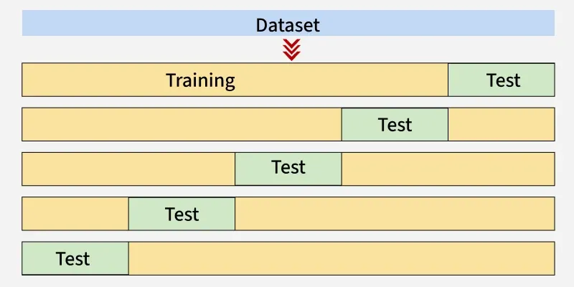
Simple Explanation
This image shows K-Fold Cross Validation.
The dataset is divided into several equal parts (folds).
In each step, one part is used as the test set (green), and the remaining parts are used for training (yellow).
The process is repeated multiple times, each time using a different fold as the test set.
Finally, the average performance of all tests is calculated to evaluate the model.
In simple words: Every part of the dataset gets a chance to be test data once and training data multiple times.

Slide 6
Here k = 5, so the dataset is divided into 5 folds.
1st Iteration: The first 20% of data (1–5) is used for testing, and the remaining 80% (6–25) is used for training.
2nd Iteration: The second 20% of data (6–10) is used for testing, and the remaining (1–5) and (11–25) data is used for training.
This process continues until all 5 folds have been used once as the test set. After that, the average performance of all iterations is calculated to evaluate the model.
Iteration | Training Set Observations | Testing Set Observations
1 | [5-24] | [0-4]
2 | [0-4, 10-24] | [5-9]
3 | [0-9, 15-24] | [10-14]
4 | [0-14, 20-24] | [15-19]
5 | [0-19] | [20-24]
Each iteration uses different subsets for testing and training, ensuring that all data points are used for both training and testing.

Slide 7
Comparison between K-Fold Cross-Validation and Holdout Method
Feature | K-Fold Cross-Validation | Holdout Method
Data Split | Dataset is divided into k folds, and each fold is used once as the test set | Dataset is split once into training and testing sets
Training & Testing | Model is trained and tested k times, each fold becomes the test set once | Model is trained once and tested once
Bias & Variance | Lower bias and more reliable performance estimate | Higher bias if the data split is not representative
Execution Time | Slower because the model is trained k times | Faster since training happens only once
Best Use Case | Good for small to medium datasets where accurate evaluation is needed | Good for very large datasets or when quick results are needed

Slide 8
Python Implementation for K-Fold Cross-Validation
Step 1: Import Necessary Libraries
First, we import the required modules from scikit-learn.
cross_val_score is used to evaluate the model using cross-validation.
KFold is used to split the dataset into a specified number of folds.
SVC is used to create a Support Vector Classification model.
load_iris is used to load the sample Iris dataset for testing.
from sklearn.model_selection import cross_val_score, KFold
from sklearn.svm import SVC
from sklearn.datasets import load_iris

Slide 9
Step 2: Loading the Dataset
We use the Iris dataset, which is a built-in dataset in scikit-learn. It contains 150 samples of flowers belonging to three species: Setosa, Versicolor, and Virginica. This dataset is commonly used for classification problems.
iris = load_iris()
X, y = iris.data, iris.target
Step 3: Creating the SVM Classifier
SVC() from scikit-learn is used to create the Support Vector Machine (SVM) model. In this step, a linear kernel is used, which works well when the data can be separated by a straight line (linearly separable data).
svm_classifier = SVC(kernel='linear')

Slide 10
Step 4: Defining the Number of Folds for Cross-Validation
In this step, we set the number of folds as 5. This means the dataset will be divided into 5 equal parts. The model will train on 4 parts and test on the remaining 1 part.
This process is repeated 5 times, so that each fold is used once as the test set, giving a more balanced and reliable evaluation of the model.
num_folds = 5
kf = KFold(n_splits=num_folds, shuffle=True, random_state=42)
Step 5: Performing K-Fold Cross-Validation
In this step, cross_val_score() is used to perform K-Fold cross-validation. It automatically splits the data into folds, trains the model, and evaluates it on each fold. The function then returns the accuracy score for each fold.
cross_val_results = cross_val_score(svm_classifier, X, y, cv=kf)

Slide 11
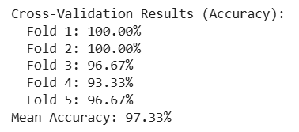
Step 6: Evaluation Metrics
In this step, we display the accuracy of each fold and also calculate the average (mean) accuracy of all folds. This helps us understand how stable the model is and how well it can generalize to new data.
print("Cross-Validation Results (Accuracy):")
for i, result in enumerate(cross_val_results, 1):
print(f" Fold {i}: {result * 100:.2f}%")
print(f'Mean Accuracy: {cross_val_results.mean()* 100:.2f}%')
Output:
The output shows the accuracy scores from each of the 5 folds in the K-Fold cross-validation process. The mean accuracy is the average of these scores, which is about 97.33%. This value represents the overall performance of the model across all folds.

Slide 12
Advantages
Better performance estimate: Gives a more reliable evaluation compared to a single train-test split.
Reduces overfitting: Helps the model generalize better on unseen data.
Efficient use of data: Every data point is used for both training and testing in different iterations.
Flexible: Can be applied to different datasets and machine learning models.
Disadvantages
Computationally expensive: Requires more computation, especially when the number of folds is large.
Time-consuming: Methods like LOOCV take a long time when the dataset is very large.
Bias-Variance tradeoff: Fewer folds can cause high bias, while too many folds can lead to high variance.

Slide 13
Grid Search in Machine Learning

Slide 14
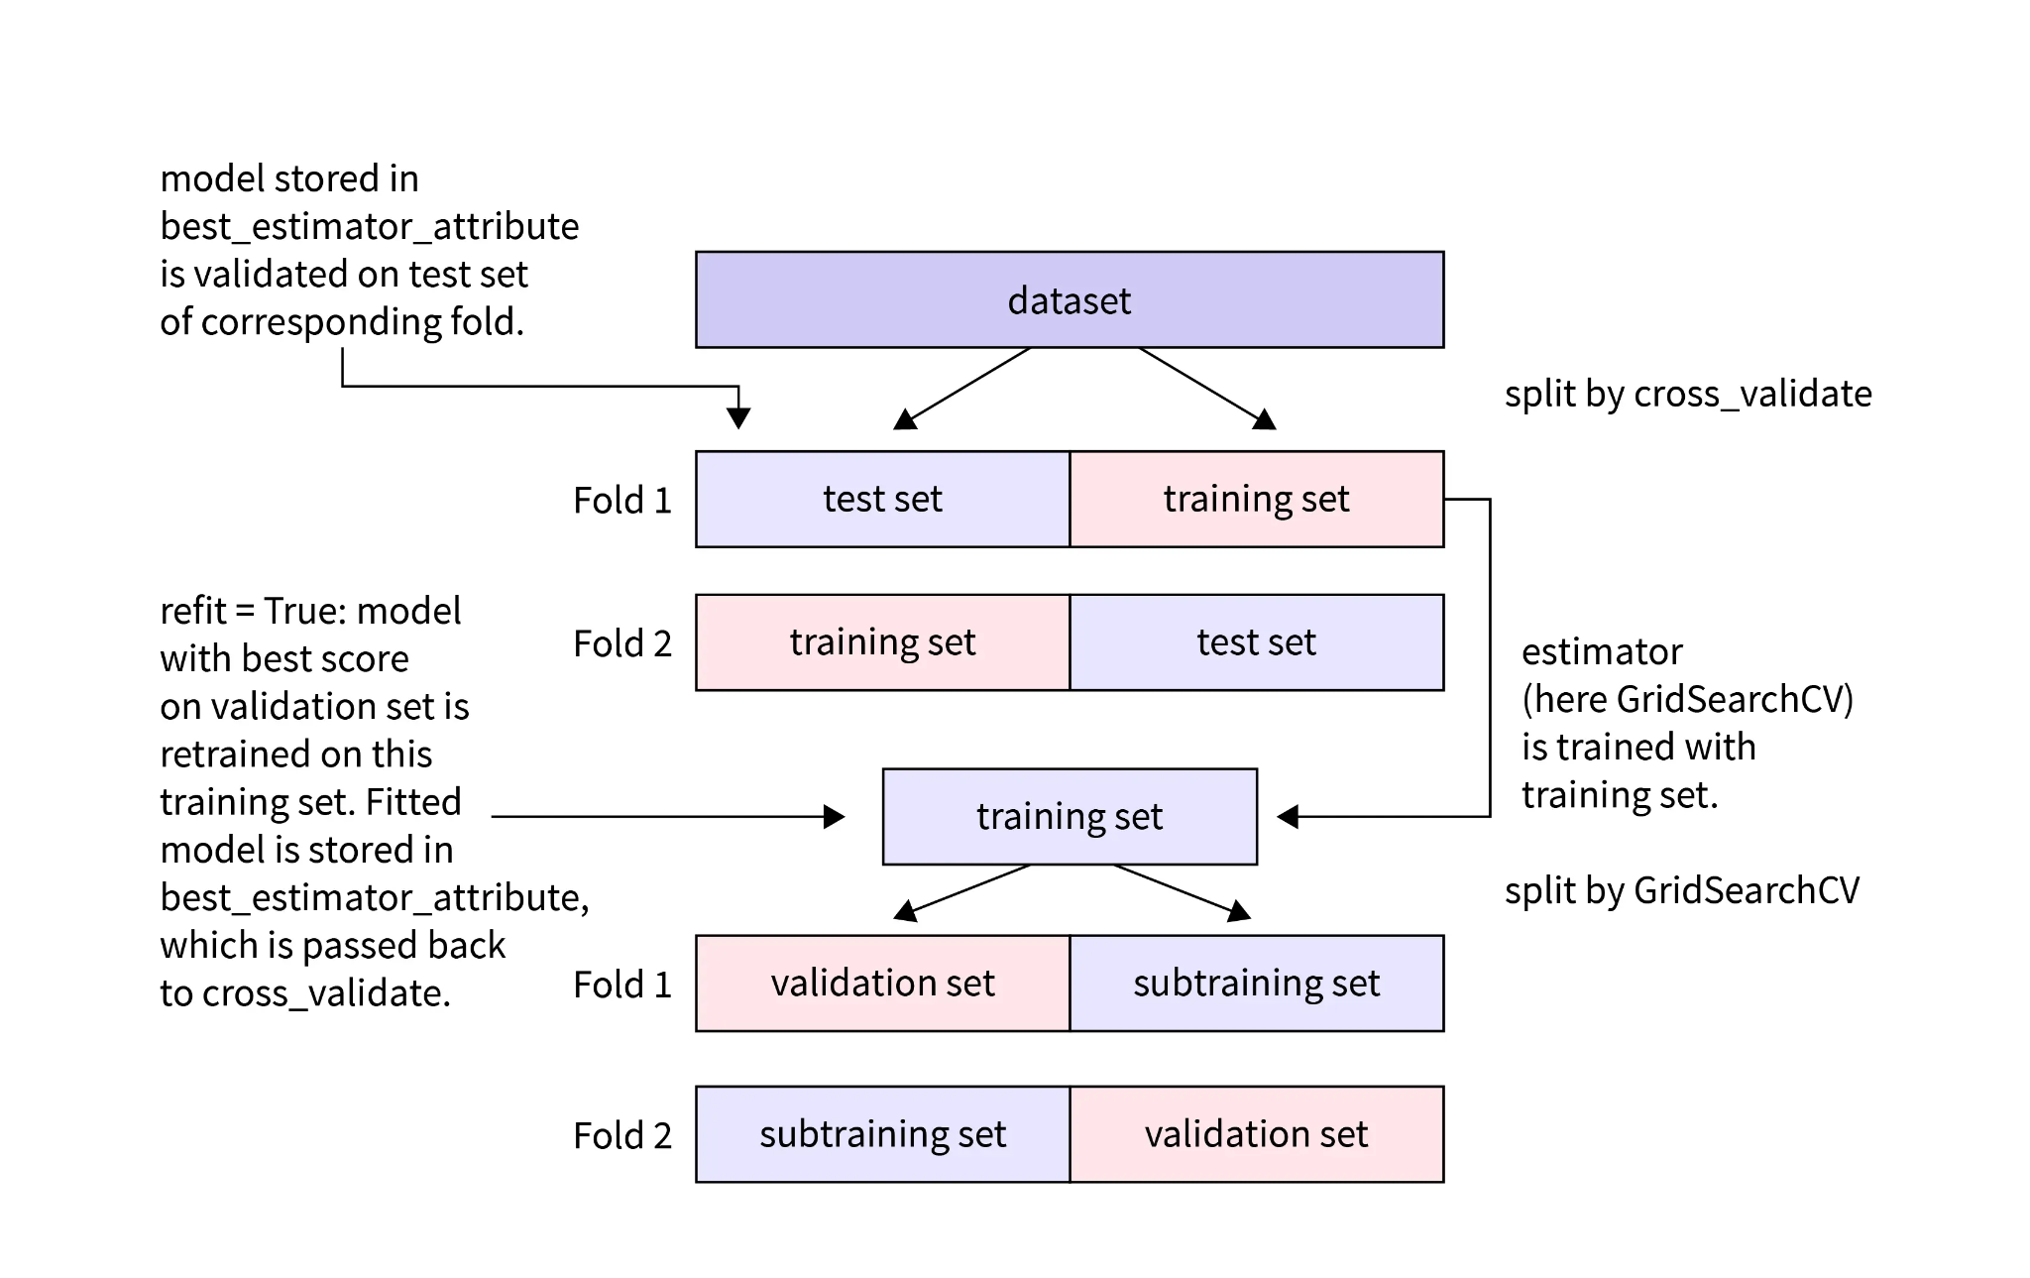
Introduction Grid Search is a machine learning technique used for hyperparameter tuning (Hyperparameter tuning is the process of selecting the best set of parameters for a machine learning algorithm to improve its performance.
Some hyperparameters are:
n_estimators → number of trees in the forest
max_depth → maximum depth of each tree
min_samples_split → minimum samples needed to split a node). It systematically tests different combinations of hyperparameters available in a machine learning algorithm to find the set that produces the best model performance.
In addition to improving model accuracy, Grid Search also provides evaluation metrics that help analyze and understand how well the machine learning model performs with different parameter combinations.

Slide 15
This diagram shows how GridSearchCV works with Cross-Validation to find the best model parameters.
1. Dataset Split (Cross Validation)
The full dataset is first divided into different folds using cross-validation.
In Fold 1, one part becomes the test set and the other part becomes the training set.
In Fold 2, the roles switch: the previous training part becomes the test set.
This ensures every data point is used for both training and testing.
2. Model Training
The estimator (GridSearchCV) is trained using the training set obtained from cross-validation.
3. Further Split for Grid Search
Inside the training data, GridSearchCV again splits the data into:
Sub-training set – used to train the model with different hyperparameter combinations.
Validation set – used to evaluate which hyperparameter combination performs best.

Slide 16
4. Hyperparameter Testing
GridSearch tries multiple combinations of parameters and checks their performance on the validation set.
5. Selecting Best Model
The model with the best validation score is selected and stored in best_estimator_.
6. Refit Step
If refit=True, the best model is retrained on the entire training data to build the final model.
7. Final Evaluation
The final model is then validated on the test set of the corresponding fold to measure its performance.

Slide 17
Ways to Improve Machine Learning Model Performance
A common approach in Machine Learning is to try different algorithms and compare their performance to see which model gives better accuracy. However, this process can be optimized to make model selection more efficient.
1. Optimizing the Choice of the Best Machine Learning Model
Selecting the right dataset is an important part of Machine Learning because datasets help us understand the relationship between dependent and independent variables. In simple datasets, these relationships can often be identified easily, while in complex datasets it may be harder to detect them.
If the relationship between variables is clear, we can directly choose suitable algorithms. For example, if the relationship between variables appears linear and the number of features is small, the Linear Regression algorithm can be used.
To build a robust and well-performing model, the dataset is usually divided into training data and testing data. Multiple models are trained using the training dataset, and their performance is evaluated using the testing dataset. The model that produces the lowest error on the test data is selected as the best model.

Slide 18
2.Optimizing a Model’s Fit using Hyperparameter Tuning
Selecting a suitable Machine Learning algorithm based on the dataset is one way to improve model performance. However, a more effective approach is hyperparameter tuning, which focuses on optimizing the model’s configuration.
Hyperparameters are the settings or configurations that control the training process of a Machine Learning model. These parameters are set before training begins and can significantly affect the model’s accuracy and performance.
By adjusting these hyperparameters, we can improve how well the model fits the data and reduce errors on the testing dataset. Grid Search is a popular technique used for this purpose. It tests multiple combinations of hyperparameters and identifies the best set of values that improves accuracy and minimizes prediction error.

Slide 19
DecisionTreeClassifier(ccp_alpha=0.0,class_weight=None,criterion='gini',max_depth=None,max_features=None,
max_leaf_nodes=None,min_impurity_decrease=0.0,min_samples_leaf=1,min_samples_split=2,min_weight_fraction_leaf=0.0,random_state=None,splitter='best')
ccp_alpha – Controls pruning of the tree to reduce overfitting.(Pruning is the process of removing unnecessary branches from a decision tree to make the model simpler and prevent overfitting.)
class_weight – Assigns weights to classes to handle imbalanced datasets.
criterion – Measures the quality of a split.
max_depth – Limits the maximum depth of the decision tree.
max_features – Number of features considered when looking for the best split.
max_leaf_nodes – Limits the number of leaf nodes in the tree.
min_impurity_decrease – A split occurs only if impurity decreases by this value.
min_samples_leaf – Minimum number of samples required in a leaf node.
min_samples_split – Minimum number of samples required to split a node.
min_weight_fraction_leaf – Minimum weighted fraction of samples required at a leaf node.
random_state – Controls randomness to produce reproducible results.
splitter – Strategy used to choose the best split at each node.

Slide 20
What is Grid Search?
Grid Search is a technique used in Machine Learning to find the best combination of hyperparameters for a model. It tries different values of parameters and selects the combination that gives the best performance (high accuracy and low error).
The “Search” in Grid Search
The word search means that the method tests many combinations of hyperparameters. It checks each combination and evaluates the model to find which set of parameters works best.
The “Grid” in Grid Search
The word grid refers to the structured list of parameter values we create. These values form a grid of possible combinations, and the model is trained and tested on each combination to find the optimal one.

Slide 21
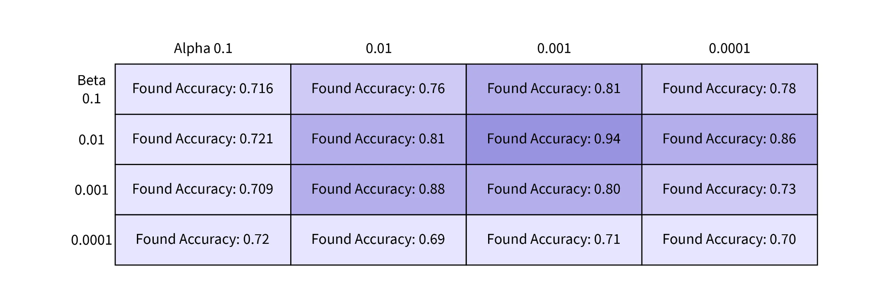
This image shows how Grid Search tests different hyperparameter combinations.
The columns represent different values of Alpha (0.1, 0.01, 0.001, 0.0001).
The rows represent different values of Beta (0.1, 0.01, 0.001, 0.0001).
Each cell shows the accuracy obtained for that Alpha–Beta combination.(Alpha–beta combination in Grid Search means testing multiple pairs of hyperparameter values to find the best performing model.)
Grid Search trains the model for every combination and records the accuracy.
From the table, the best accuracy is 0.94, which occurs when Alpha = 0.001 and Beta = 0.01. So, Grid Search helps find the best hyperparameter combination that gives the highest accuracy.

Slide 22
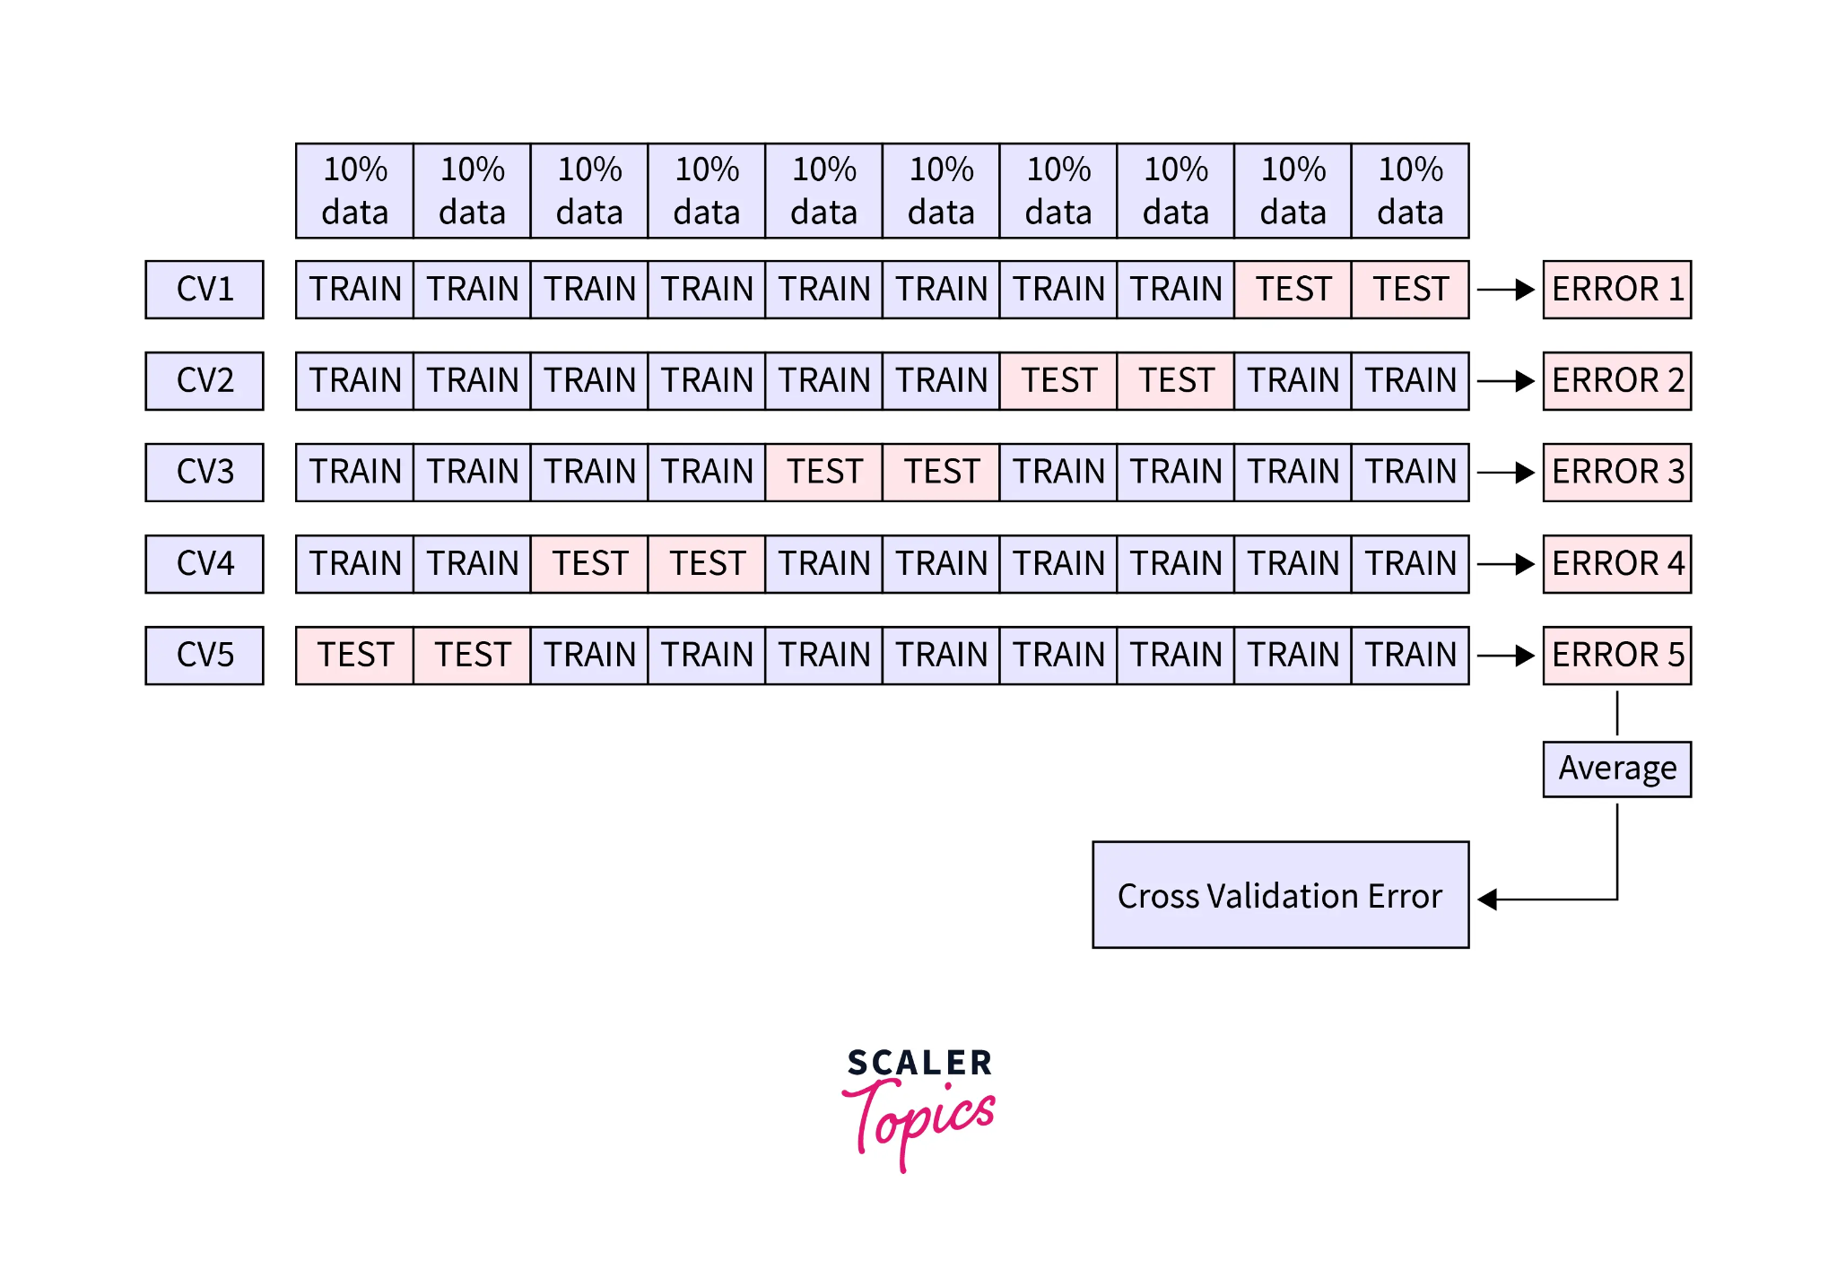
The grid defines the range of values that will be tested for each hyperparameter. Grid Search then checks different combinations of these values within that range. In simple terms, the grid tells the model which parameter values should be tried during tuning.
The “Cross-Validation” in Grid Search
In Machine Learning, some hyperparameter combinations may perform very well on training data but poorly on unseen data, which leads to overfitting. To reduce this problem, cross-validation is used. It evaluates the model on different splits of the dataset and calculates the average validation error, giving a more reliable measure of model performance.
This image shows 5-Fold Cross Validation.
The dataset is divided into 10 equal parts (10% each).
In each round (CV1 to CV5), most parts are used for training and some parts are used for testing.
The model is trained and tested 5 different times, producing Error 1, Error 2, Error 3, Error 4, and Error 5.
Finally, the average of these errors is calculated.
This average error is called the Cross Validation Error, which gives a more reliable measure of model performance.

Slide 23
The dataset is divided into K equal parts (K = number of folds). The model is trained K times, and in each round one part is kept aside for testing while the remaining parts are used for training.
The left-out part is used to calculate the error and evaluate the model’s performance. After all K rounds are completed, the average of all the errors is calculated, which is called the cross-validation error.
This process reduces bias and gives a more reliable evaluation of the model’s performance.
Why is Grid Search Important?
Automation is widely used by developers to make tasks easier and faster. Grid Search helps automate the process of finding the best combination of hyperparameters for a machine learning model.
It systematically tests different parameter combinations and identifies the set that gives the best model performance.
However, some tasks still need to be done manually, such as choosing the evaluation metric, selecting the machine learning algorithm, and preparing the dataset. Grid Search mainly helps by automating the process of testing multiple hyperparameter combinations, which saves time and effort.

Slide 24
Implementation of Grid Search in Python
Since we know the basics of Grid Search, let us go on and implement it using GridSearchCV provided by sklearn.
# Importing all the necessary libraries
import pandas as pd
from sklearn.ensemble import RandomForestClassifier
from sklearn.model_selection import train_test_split
from sklearn.model_selection import GridSearchCV
from sklearn import metrics
# Reading our dataset
df = pd.read_csv('heart.csv')
# Independent variables
X = df.drop('target', axis = 1)
# Target variable
y = df['target']
# Splitting our dataset into train and test
X_train, X_test, y_train, y_test = train_test_split(X, y, test_size = 0.3, random_state = 42)
# Random Forest Classifier
rfc = RandomForestClassifier()
# Limit of parameters
forest_params = [{'max_depth': list(range(10, 15)), max_features: list(range(1,14))}]
# GridSearchCV
clf = GridSearchCV(rfc, forest_params, cv = 10, scoring='accuracy')
clf.fit(X_train, y_train)
# Printing our best metrics
print(clf.best_params_)
print(clf.best_score_)
Output :
{'max-depth': 13, 'max-features': 3}
0.9818075
After execution, we can see the best parameters we can use and the best score we can achieve on our model.

Slide 25
Limitations of Grid Search
Time-Consuming Process Grid Search tries every possible combination of hyperparameters defined in the grid. When there are many
parameters and many values for each parameter, the number of combinations becomes very large.
As a result, the model has to be trained many times, which makes the process slow and time-consuming.
2. High Computational Cost Since the model is trained repeatedly for different parameter combinations, Grid Search requires high
computational power and memory. If cross-validation is also used, the number of model trainings increases
even more.
3. Not Efficient for High-Dimensional Data When the dataset has many features or many hyperparameters, the search space becomes very large.
In such cases, Grid Search may take too much time to complete and may not be practical for very complex
problems.
4. May Test Unnecessary Combinations Grid Search checks all combinations in the grid, even those that may not improve the model.
This makes the process less efficient compared to other methods like Random Search or Bayesian
Optimization.

Slide 26
Conclusion
Grid Search is a technique used to find the best combination of hyperparameters for a machine learning model. Choosing the right hyperparameters helps improve model accuracy and reduce prediction error.
Grid Search automatically tests different parameter combinations to identify the best settings for the model.
Evaluation metrics and cross-validation help measure the model’s performance during the Grid Search process and make the results more reliable.
However, Grid Search also has some limitations, such as high computation time and difficulty when working with large or complex datasets.

Slide 27
Randomized Search

Slide 28
Optimizing hyperparameters is one of the most difficult parts of developing machine learning and artificial intelligence models. It is difficult to predict the best parameter values when building a model, especially in the first few attempts. So, how can we find the best hyperparameter values? One method is Random Search in machine learning.
Introduction
In machine learning, Random Search is a method that uses random combinations of hyperparameters to find the best result for a model. Since the parameters are selected randomly and no specific strategy is used to choose them, chance plays a role in finding the best combination.
Hyperparameter search is a useful technique for finding the most suitable values for hyperparameters. There are different methods to perform hyperparameter search, and one of them is Random Search in machine learning.

Slide 29
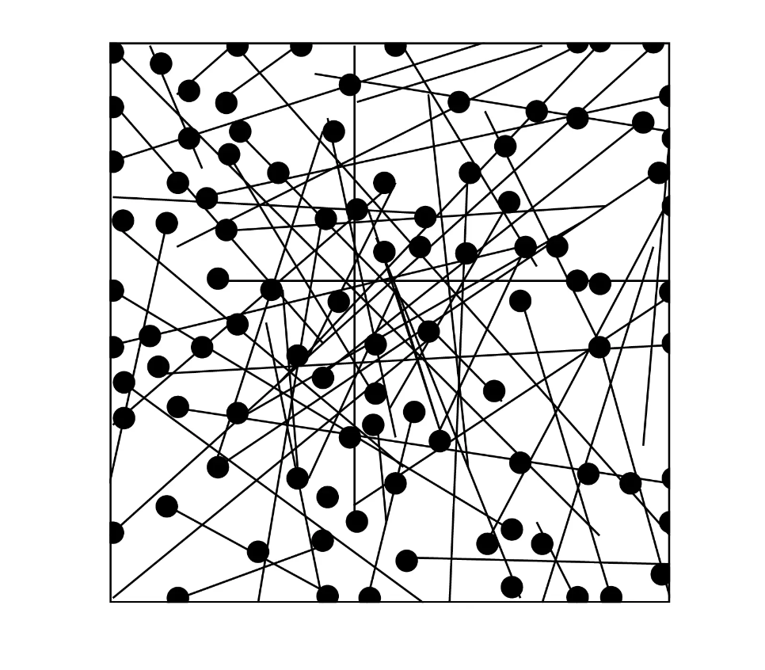
What is Random Search?
Random Search in machine learning involves generating and testing random combinations of inputs (hyperparameters) for the objective function. It is useful because it does not assume anything about the structure of the objective function. This helps in problems where domain knowledge might influence or bias the optimization process, allowing the model to find solutions that may not be obvious. The main drawback of Random Search is that it can produce high variance during computation.
The graphic below shows the pattern of Random Search.

Slide 30
The Algorithm How Random Search Works
Random Search is a method used to find the best hyperparameters for a machine learning model. Instead of testing every possible combination, it randomly selects different combinations and checks which one works best.
Step-by-Step Process
First, choose a random combination of hyperparameters from the search space. Call this combination x.
Train the model using x and calculate the cost (or error) of the model.
Then choose another random combination of hyperparameters. Call this y.
Train the model using y and calculate its cost.
Compare the two results:
If y gives a lower cost (better result) than x, then replace x with y.
If y is worse, keep x.
Repeat this process many times until:
a fixed number of iterations is reached, or
a good result is found.

Slide 31
Simple Real-Life Example
Imagine you are trying to make the best coffee.
You change three things:
coffee powder amount
milk amount
sugar amount
Instead of trying every possible combination, you randomly try different combinations like:
Try 1: more sugar, less milk
Try 2: less sugar, more coffee
Try 3: medium sugar, medium milk
Then you taste each one and keep the best recipe.
This is exactly how Random Search finds the best model parameters.
Random Search randomly tries different hyperparameter combinations and keeps the one that gives the best model performance.

Slide 32
Advantages of Random Search Over Grid Search
Random search gives better results than grid search when the number of hyperparameters and dimensions is high.
Random search allows us to limit the number of hyperparameter combinations to test, while grid search checks all possible combinations.
Random search often provides better results than grid search in fewer iterations.

Slide 33
Code Example
For this code demonstration, we will use the Heart Disease dataset.
1.Building a Base Model First, we will build a default Decision Tree Classifier and use it as our base model. Then, we will compare its results with the results obtained after performing hyperparameter tuning.
import numpy as np
import pandas as pd
import seaborn as sns
import matplotlib.pyplot as plt
df = pd.read_csv("heart_disease.csv")
X = df.drop(columns="target")
y = df["target"]
from sklearn.model_selection import train_test_split
X_train, X_test, y_train, y_test = train_test_split(X, y, test_size=0.10, shuffle=True, random_state=0)
from sklearn.tree import DecisionTreeClassifier
dtclf = DecisionTreeClassifier(random_state=42)
dtclf.fit(X_train, y_train)
y_pred = dtclf.predict(X_test) # Predictions
y_true = y_test # True values
from sklearn.metrics import accuracy_score
print("Train accuracy:", np.round(accuracy_score(y_train, dtclf.predict(X_train)), 2))
print("Test accuracy:", np.round(accuracy_score(y_true, y_pred), 2))
Output:
Train accuracy: 1.0
Test accuracy: 1.0

Slide 34
2. Python Implementation of Random Search
In Python, Random Search can be implemented using the RandomizedSearchCV function from the Scikit-learn library.
Parameters used in Random Search:
param_distributions – Defines the search space for hyperparameters.
n_iter – Number of random hyperparameter combinations to be selected.
scoring – The evaluation metric used to measure the model’s performance.
random_state – Controls the randomness of the hyperparameter combinations selected in each run.
n_jobs – Specifies the number of parallel jobs to run during the search.
cv – Number of cross-validation folds.
In this example, the total possible combinations are 100 (10 × 10). Setting n_iter = 10 means that only 10 random hyperparameter combinations will be selected. Therefore, Random Search only needs to train 10 different models instead of testing all combinations.

Slide 35
import time
start = time.time()
# Defining 3-dimensional hyperparameter space as a Python dictionary
hyperparameter_space = {'max_depth':[2,3,4,6,8,10,12,15,20],
'min_samples_leaf':[1,2,4,6,8,10,20,30],
'min_samples_split':[1,2,3,4,5,6,8,10]}
from sklearn.model_selection import RandomizedSearchCV
rs = RandomizedSearchCV(dtclf, param_distributions=hyperparameter_space,
n_iter=10, scoring="accuracy", random_state=0,
n_jobs=-1, cv=10, return_train_score=True)
rs.fit(X_train, y_train)
print("Optimal hyperparameter combination:", rs.best_params_)
print()
print("Mean cross-validated training accuracy score:", rs.best_score_)
rs.best_estimator_.fit(X_train, y_train)
y_pred = rs.best_estimator_.predict(X_test) # Predictions
y_true = y_test # True values
print("Test accuracy:", np.round(accuracy_score(y_true, y_pred), 2))
end = time.time()
diff = end - start
print('Execution time of Random Search (in Seconds):', diff)
OUTPUT:
Optimal hyperparameter combination: {'min_samples_split': 8, 'min_samples_leaf': 6, 'max_depth':12}
Mean cross-validated training accuracy score: 0.9099462365591396
Test accuracy:
Execution time of Random Search (in seconds): 0.2303011417388916

Slide 36
3. Python Implementation of Grid Search
In Python, Grid Search can be implemented using the GridSearchCV function from the Scikit-learn library. The parameters are similar to those used in Random Search, but param_distributions is called param_grid here.
In this example, the search space is three-dimensional with 576 (9 × 8 × 8) possible combinations. This means that Grid Search trains 576 different models, which is much higher compared to the 10 models trained using Random Search.
# Let's measure execution time too
import time
start = time.time()
# Defining 3-dimensional hyperparameter space as a Python dictionary
hyperparameter_space = {'max_depth':[2,3,4,6,8,10,12,15,20],
'min_samples_leaf':[1,2,4,6,8,10,20,30],
'min_samples_split':[1,2,3,4,5,6,8,10]}
from sklearn.model_selection import GridSearchCV
gs = GridSearchCV(dtclf, param_grid=hyperparameter_space,
scoring= "accuracy",
n_jobs=-1, cv=10, return_train_score=True)
gs.fit(X_train, y_train)
print("Optimal hyperparameter combination:", gs.best_params_)
print()
print("Mean cross-validated training accuracy score:", gs.best_score_)
gs.best_estimator_.fit(X_train, y_train)
y_pred = gs.best_estimator_.predict(X_test) # Predictions
y_true = y_test # True values
print("Test accuracy:", np.round(accuracy_score(y_true, y_pred), 2))
end = time.time()
diff = end - start
print('Execution time of Grid Search (in Seconds):', diff)
OUTPUT:
Optimal hyperparameter combination: {'max_depth':6, 'min_samples_leaf': 6, 'min_samples_split': 2}
Mean cross-validated training accuracy score: 0.9923544973544973
Test accuracy: 1.0
Execution time of Random Search (in seconds): 7.455021381378174

Slide 37
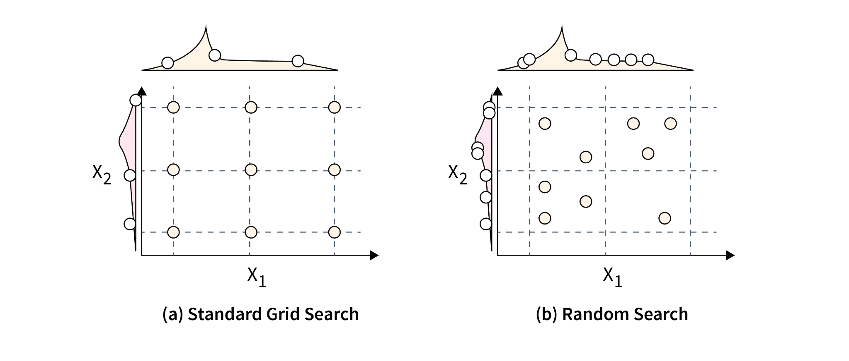
Comparison
In this case, both Grid Search and Random Search give similar results. However, Random Search is much faster. In this example, it is 32 times faster (7.5 / 0.23). This means that if Random Search takes 1 minute, Grid Search would take about 44 minutes. Therefore, when the search space is large and contains many hyperparameter combinations, Random Search is usually preferred.
This image compares Grid Search and Random Search for hyperparameter tuning.
Grid Search (left): The algorithm tests all possible combinations of parameters X1X_1X1​ and X2X_2X2​ at fixed grid points. It is systematic but takes more time.
Random Search (right): The algorithm tests random combinations of parameters in the search space. It checks fewer points, so it is faster and often finds good results quickly.

Slide 38
Conclusion
Random Search is a hyperparameter tuning technique often used when the search space has high dimensionality.
It usually performs better than Grid Search, but it does not always guarantee the best hyperparameters.
Random Search replaces exhaustive search by selecting hyperparameter values randomly.

Slide 39
Saving and Loading Models in Machine Learning

Slide 40
Introduction
In machine learning, training a model can take a lot of time and computational resources.
Once a model is trained, it is useful to save the model so that it can be reused later without retraining.
Saving and loading models allows developers to store trained models on disk and load them whenever needed
for predictions or deployment. This is commonly used in real-world applications where models are trained once
and used multiple times.
Why Saving Models is Important
1. Avoid Retraining – Training models repeatedly is time‑consuming. Saving allows reuse of trained models.
2. Deployment – Models used in applications or APIs must be saved and loaded.
3. Reproducibility – Saved models allow experiments to be reproduced later.
4. Sharing Models – Models can be shared with other developers or teams.

Slide 41
Common Methods to Save and Load Models in Python
The most common methods are:
• Pickle – Python built‑in library used to serialize Python objects.
• Joblib – Efficient library commonly used with Scikit‑learn models.
• Model‑specific saving – Libraries such as TensorFlow or PyTorch provide their own saving methods.
Method 1: Using Pickle
Pickle is a Python library used to serialize and deserialize Python objects.
Serialization means converting an object into a format that can be stored in a file.

Slide 42
Example: Saving a Model using Pickle
import pandas as pd
from sklearn.model_selection import train_test_split
from sklearn.tree import DecisionTreeClassifier
import pickle
data = pd.read_csv("heart.csv")
X = data.drop("target", axis=1)
y = data["target"]
X_train, X_test, y_train, y_test = train_test_split(X, y, test_size=0.2)
model = DecisionTreeClassifier()
model.fit(X_train, y_train)
with open("model.pkl", "wb") as file:
pickle.dump(model, file)
print("Model saved successfully")

Slide 43
Example: Loading a Model using Pickle
import pickle
with open("model.pkl", "rb") as file:
loaded_model = pickle.load(file)
prediction = loaded_model.predict([[63,1,3,145,233,1,0,150,0,2.3,0,0,1]])
print(prediction)

Slide 44
Method 2: Using Joblib
Example: Saving a Model using Joblib
import joblib
from sklearn.tree import DecisionTreeClassifier
model = DecisionTreeClassifier()
model.fit(X_train, y_train)
joblib.dump(model, "model_joblib.pkl")
Example: Loading a Model using Joblib
import joblib
loaded_model = joblib.load("model_joblib.pkl")
prediction = loaded_model.predict([[63,1,3,145,233,1,0,150,0,2.3,0,0,1]])
print(prediction)

Slide 45
Pickle vs Joblib
Pickle:
• Built‑in Python library
• Slower for large models
Joblib:
• Faster and optimized for large NumPy arrays
• Recommended for Scikit‑learn models
Advantages
• Saves training time
• Enables deployment
• Allows reuse of trained models
• Easy model sharing
Limitations
• Saved models may not work with different library versions.
• Loading untrusted pickle files may cause security risks.
• Model files can become corrupted if not stored properly.

Slide 46
Best Practices
• Save models after training is complete.
• Save preprocessing objects such as scalers or encoders.
(A scaler is used to normalize or standardize numerical data before training the model.
Examples: StandardScaler, MinMaxScaler)
(An encoder converts categorical data into numerical values, because machine learning models work only with numbers.
Examples: OneHotEncoder, LabelEncoder, OrdinalEncoder)
• Use Joblib for large models.
• Keep models in a dedicated 'models' folder.
• Maintain model version control.

Slide 47
Conclusion
Saving and loading models is an essential part of the machine learning workflow.
It allows trained models to be reused without retraining, saving both time and computational resources.
In Python, models are commonly saved using Pickle or Joblib, with Joblib often preferred for large models

